Slide 1
Feel Free to check your emotions for the day!! Emotion Sensor

Slide 2
Contents
Motivation & Objective
Daily Activity Report
Application Features
Software Specifications
System Architecture
Gestures used – Motion Models
Data Preparation
Recommendations
Accuracy – Precision/Recall/F-Measure
Project Working DEMO
Limitations & Future Scope
Bibliography & Project Video

Slide 3
Motivation & Objective
A Person goes thru all the emotions everyday – Happy, Sad, Super Excited, Irritated and most of the day Idle.
At the end of his day how will it be if he goes thru an activity report which shows him all his emotions for that particular day.
Also, we recommend the user to do something based on how he spent the day, just to uplift his/her mood further.
Recommendations varies with the users. User can be a Kid, a working individual, or a Student.
Our Android Mobile Application ‘What To Do?’ does the same….

Slide 4
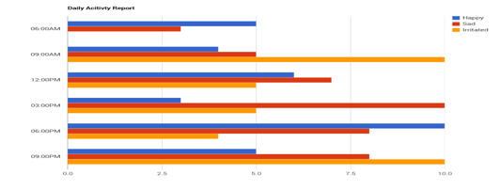
Daily Activity Report

Slide 5
Application Features
What To Do – works on an android platform and its important feature is Emotion Recognition.
Emotions are detected based on the Hand Gestures of the User.
We use Sensor Tag to capture the gestures.
For example:
If you make a hand gesture which resembles a ‘Stomp’, it indicates that you are ‘Irritated’.
If you give a ‘High-Five’, it means you are ‘Happy’.
We also use Google charts for designing the reports based on the data that is being collected and also developed a recommendation system.

Slide 6
Software Specifications
Tools: Android Development Kit, R, Sensor Tag (External Tool), Google Charts for activity report
Operating System: Android
Development Operating System: Windows 8
Programming Language: Java 7.0
Databases: HBase

Slide 7
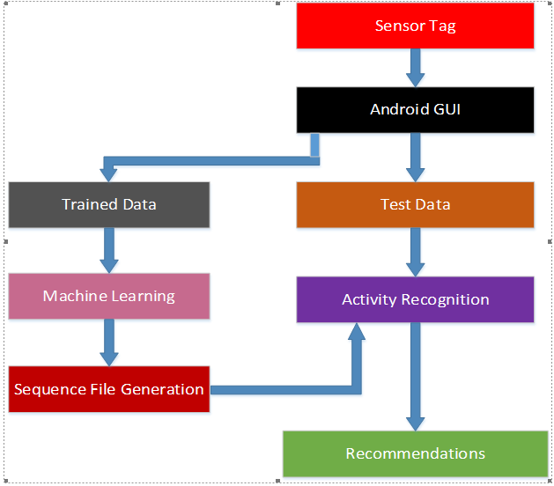
System Architecture

Slide 8
Gestures used – Motion Models
Hand Gestures we considered for our project:
Face palm Hand gesture is represented as worried
Weeping Hand gesture is represented as Sad
Stomp hand gesture is represented as Irritated
Punch hand gesture is represented as Angry.
High Five hand gesture is represented as Happy.

Slide 9
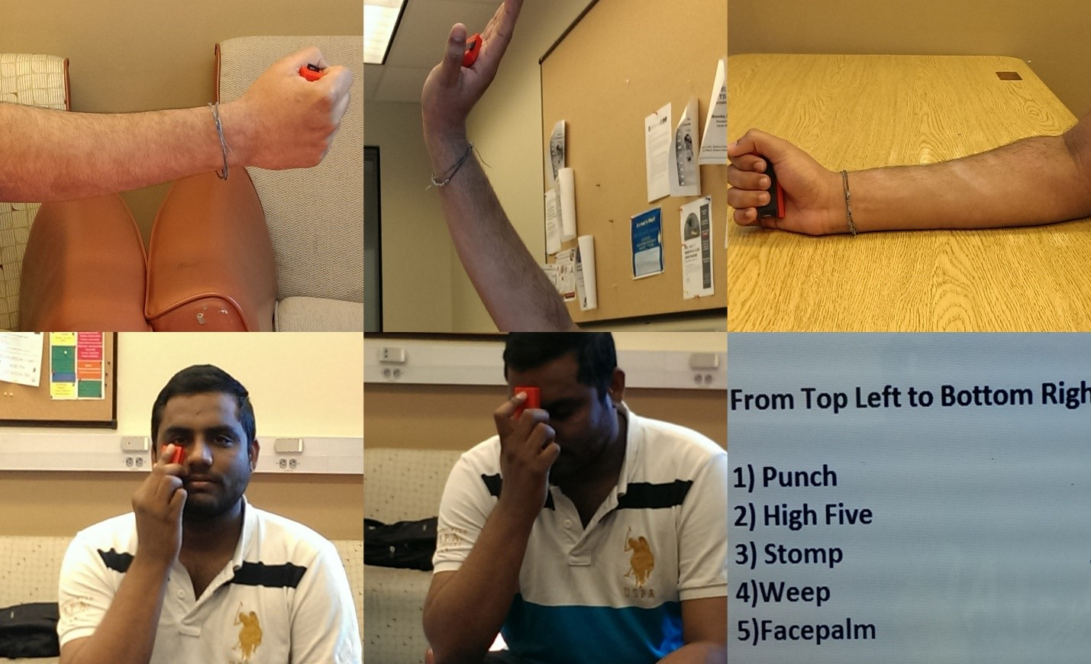
Different Gestures:

Slide 10
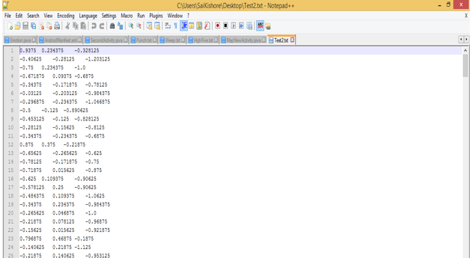
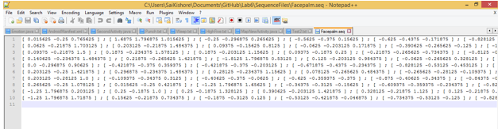
Data Preparation:
Data has been collected using the sensor tag.
After recording each gesture, we will be using these files for machine learning to generate the sequence files.

Slide 11
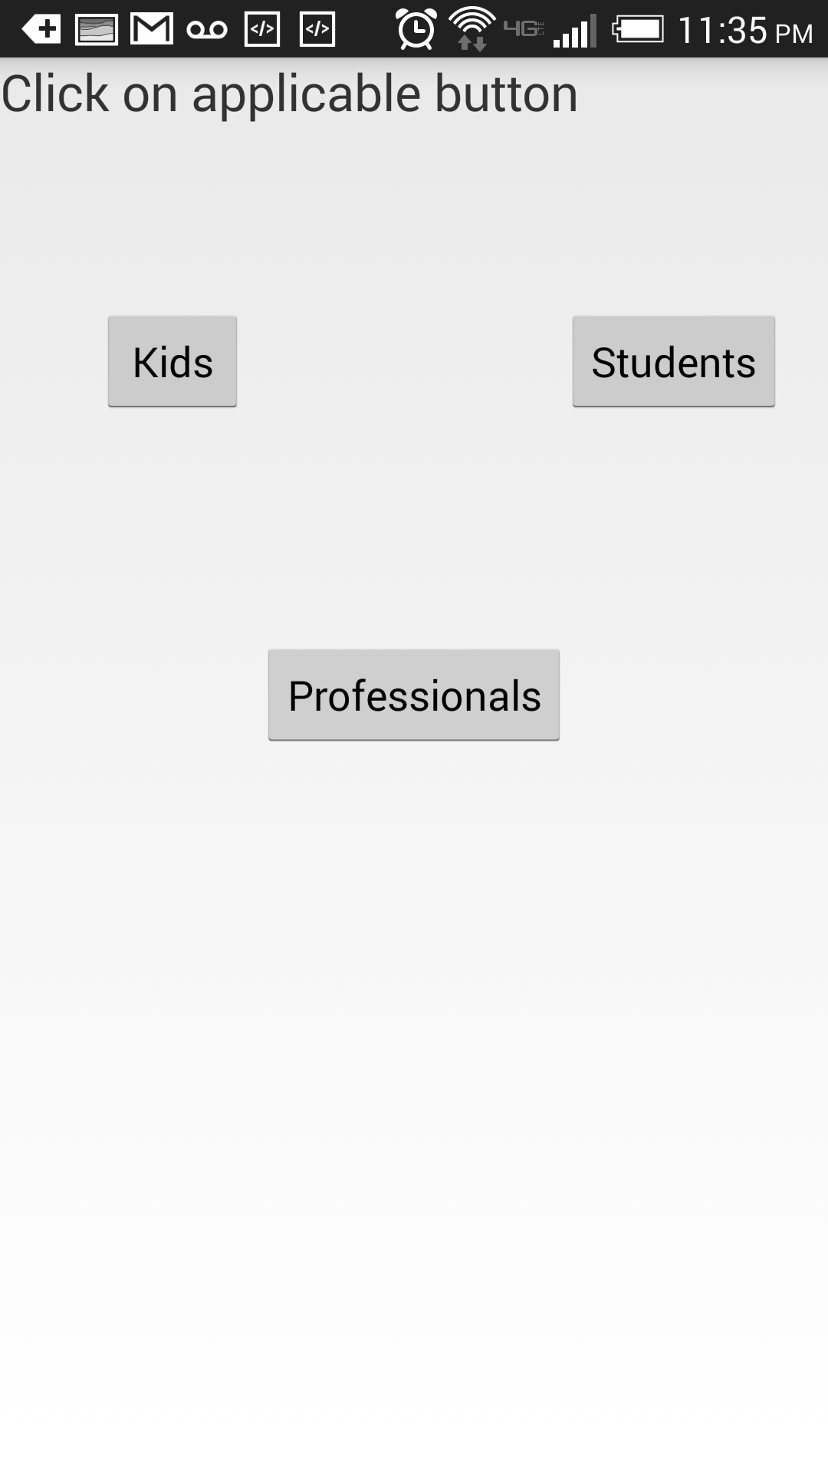
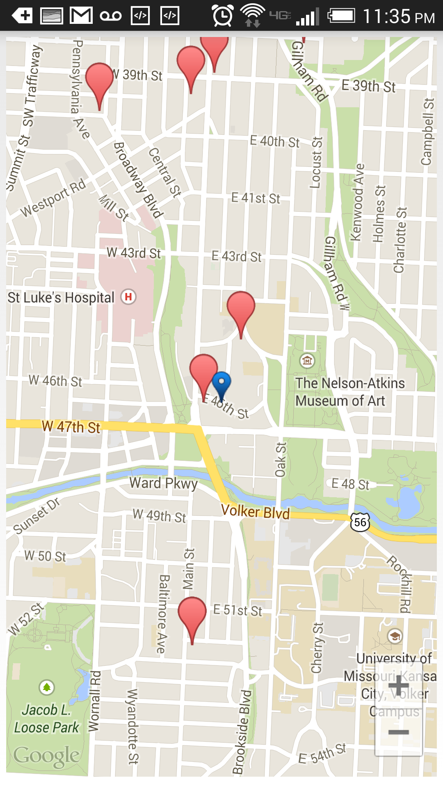
Recommendations:

Slide 12
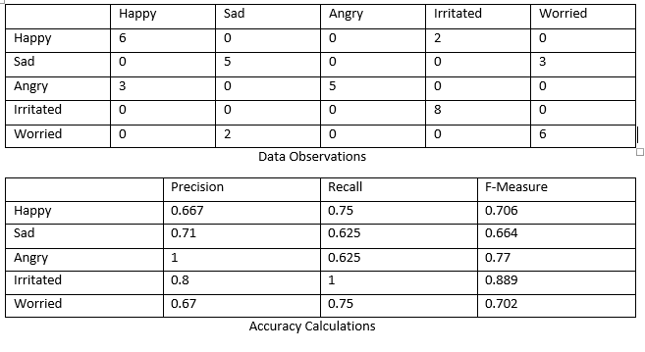
Accuracy – Precision/Recall/F-Measure

Slide 13
DEMO

Slide 14
Limitations & Future Scope
Limitations:
There are certain issues in detecting the irritating motion as it is mapping with happy gesture. But this was rarely observed.
The application doesn’t support any inbuilt sensors and is applied only for the sensor tag designed by Texas Instruments.
Capturing Emotions based on hand gestures is a little tricky, but we just wanted to implement something new and different.
Future Scope:
As we had good accuracy with the common gestures that human perform like Face palm, Stomp etc. We can create an effective app by adding few more gestures (not just hand).

Slide 15
Bibliography & Project Video
Developing Android Applications Using Sensors: http://developer.android.com/guide/topics/sensors/sensors_overview.html
Microsoft research Projects: http://research.microsoft.com/en-us/projects/imanexpert/
Developing and testing recommendation Systems: http://cran.r-project.org/web/packages/recommenderlab/vignettes/recommenderlab.pdf
Google Charts for Activity Reports: https://developers.google.com/chart/
And of course: GoOgLe
Project Video: https://www.youtube.com/watch?v=sjL12Td0vFI

Slide 16
A Presentation by :
Sai Kishore, Bandaru
Laxman Dutt, Degala
Saikiran, Pasala
Avani, Kapa
Ebenezer Anand, Arapally
Under the Guidance of:
Professor Dr.Yugyung Lee
Teaching Assistant: Feichen Shen
Thank You!!

Slide 17
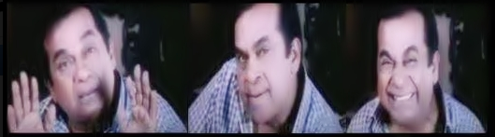
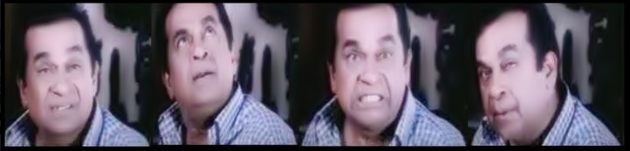
Thank You!!

